Slide 1
Operating Systems
Dr. Deepak Dembla

Slide 2
Operating System Architecture

Slide 3
Objectives
General operation of an operating system
Booting the OS
System calls, their execution and types
System programs
System generation programs
General structure of OS
Monolithic architecture
Layered architecture
Virtual machine OS
Microkernel architecture
Exo-kernel architecture
Hybrid architecture
System generation

Slide 4
General operation of an operating system
BIOS
BIOS is software that basically consists of input-output functions. These functions are low-level routines that the operating system uses to interface to different I/O devices like keyboard, screen, ports, etc.
Booting/ Boot strapping
process to place the operating system in memory is known as booting or bootstrapping.
Boot Software/Boot Loader/Bootstrap Loader
The set of instructions needed for booting, i.e. to load the operating system in RAM is known as Boot Software/Boot Loader/Bootstrap Loader.

Slide 5
General operation of an operating system
Boot Device
The device that stores the operating system is called boot device.
Privileged instructions
the instructions which are not directly executed by the user but need to be passed to the operating system are known as privileged instructions.
System Call
All the privileged instructions, i.e. the instructions which need to interact with hardware and other resources and therefore passed to the operating system for execution, are known as system calls.

Slide 6
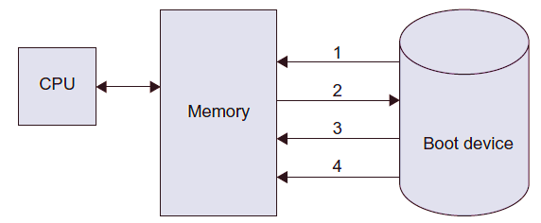
Booting Sequence

Slide 7
System calls
System call is an instruction which requests the operating system to perform the desired operation which needs hardware access or other privileged operations.
System call in fact generates an interrupt that causes the operating system to gain the control of the CPU.
The operating system then finds out the type of the system call and the corresponding interrupt handler routine is executed to perform the operations desired by the user through the system call.
Therefore, system call is just a bridge between the user programs and operating system for executing the privileged operations

Slide 8
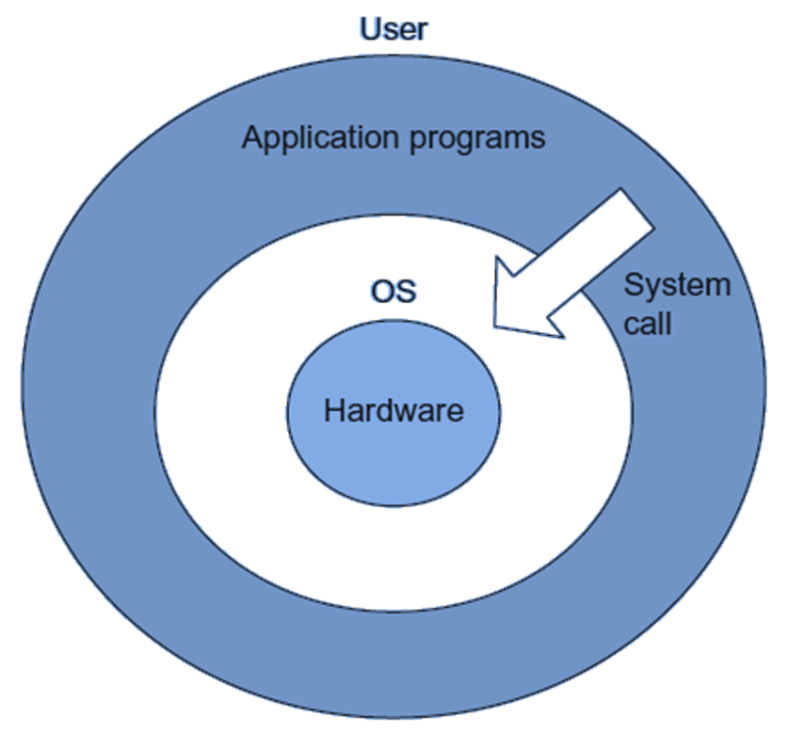
System call interface

Slide 9
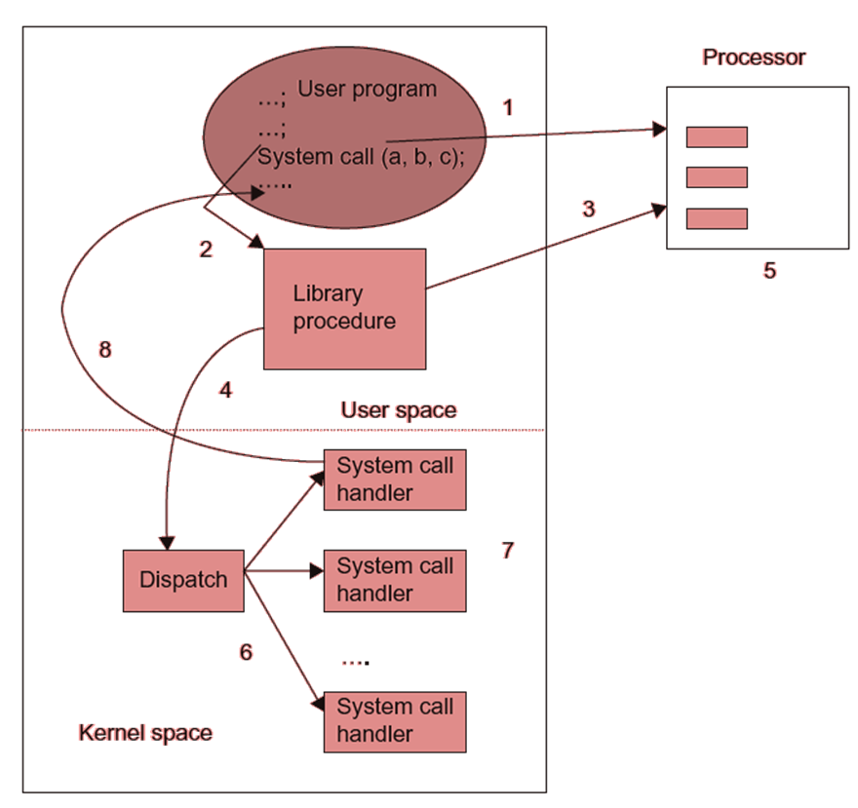
Steps to execute a system call

Slide 10
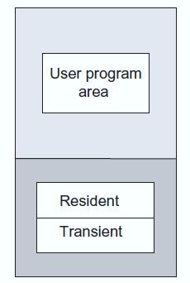
Resident and Transient parts of operating system in memory

Slide 11
Program and data structures of the resident part
Resource allocation data structures
Information regarding processes and their states
System call handler
Scheduler

Slide 12
Monolithic architecture
A complex structure of operating system because every module in the operating system accessed hardware directly.
Programming effort was high because there is a large gap between the meaning of operations required by the user and the meaning of operations performed by the hardware.
This gap is known as semantic gap between the user application and bare hardware.

Slide 13
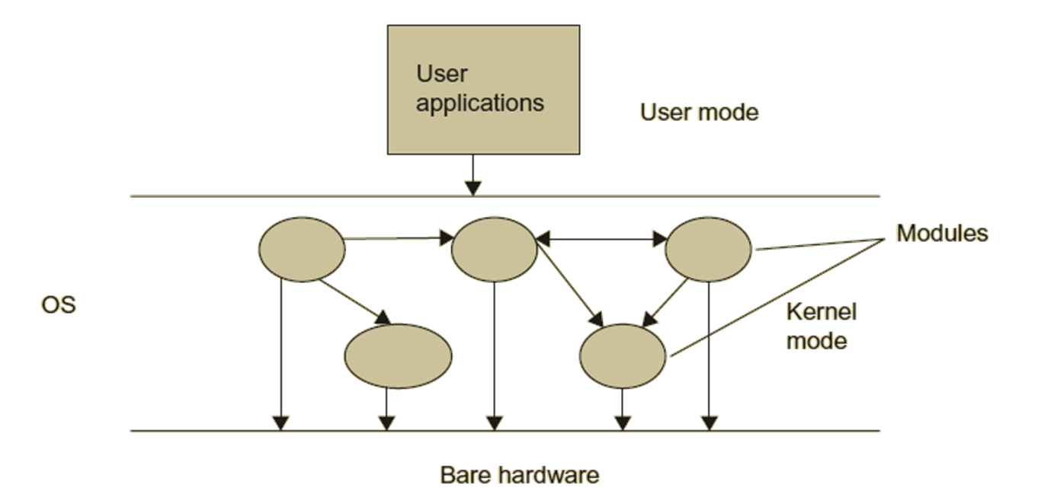
Monolithic architecture

Slide 14
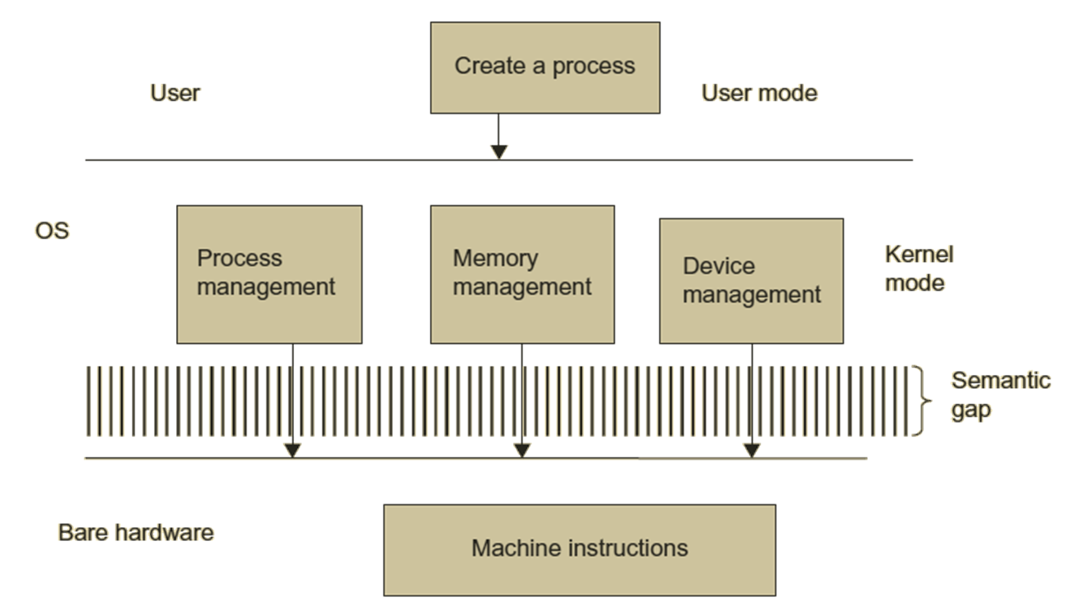
Semantic gap between OS and hardware

Slide 15
Layered architecture
Grouping of Functions in a layer
The functions related to a category are grouped together and made a layer of that category.
The top most layer provides the interface to applications of the users.
The lowest layer interacts with the underlying hardware.

Slide 16
Hierarchy of layers
Each layer can communicate with only layers immediately below or above it.
Moreover, a layer uses the services of the layer below it.
Debugging is easy.
Protection among different modules of different layers

Slide 17
Problems with layered architecture
It may suffer from efficiency problems if number of layers is more.
It may lead to again a complex architecture.
It may be difficult sometimes to isolate functionality from one another.

Slide 18
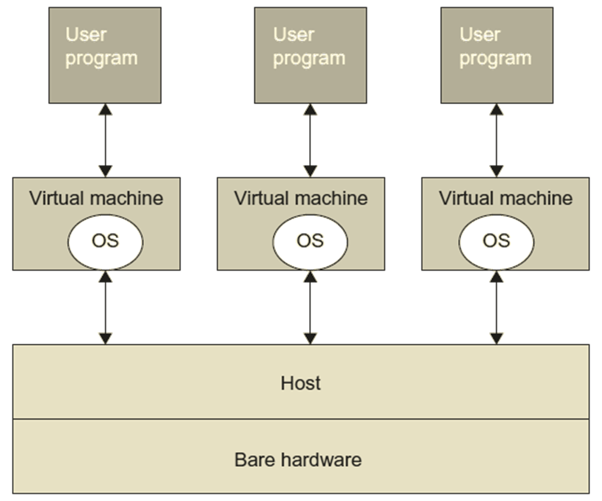
Virtual machine architecture

Slide 19
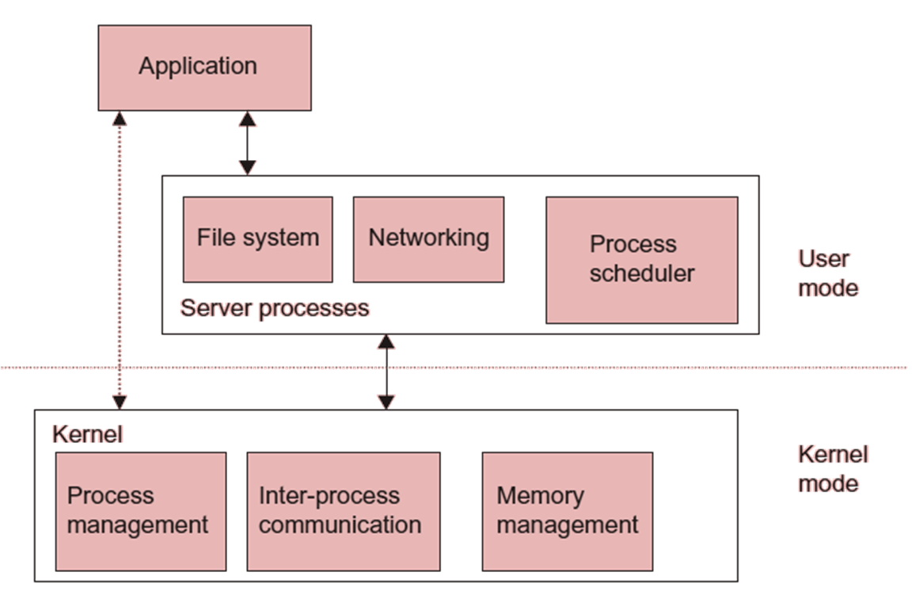
MicroKernel architecture

Slide 20
Microkernel architecture
The modules implemented outside the kernel in user space are called server processes.
The application programs of the user (Client programs) communicate with the server-processes
The communication between the client applications and server-processes is through the message passing communication method, called as IPC(Inter-process communication). also known as client server architecture of operating system.

Slide 21
Microkernel architecture
The microkernel facilitates this message passing communication by validating the messages, passes them to various modules and gives access to hardware.
The server-processes are like any other programs that allow the operating system to be modified simply by starting and stopping these server programs.

Slide 22
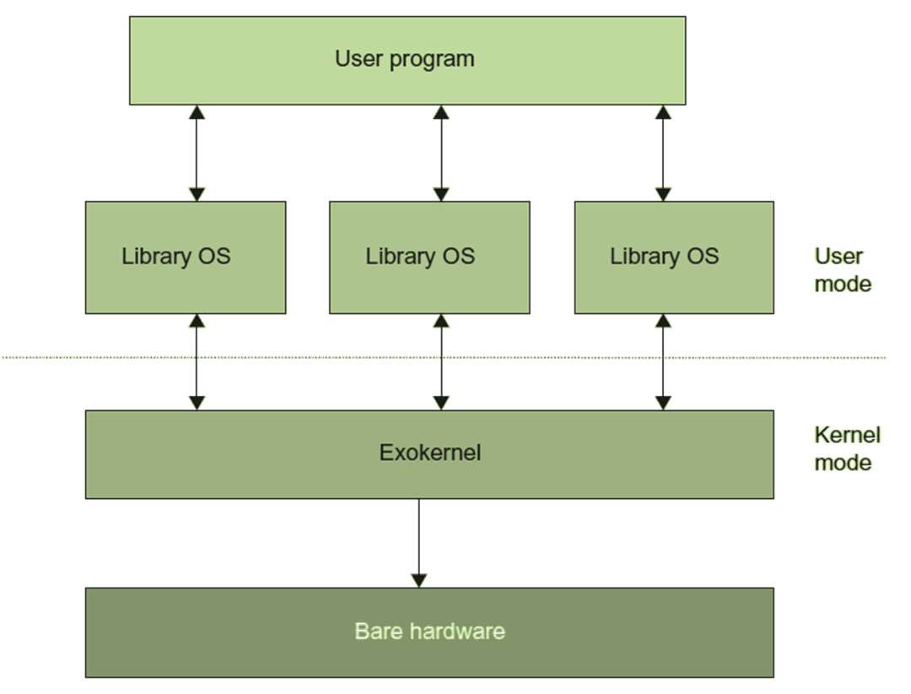
Exokernel architecture

Slide 23
Hybrid Kernel based OS,
In microkernel architecture, there was a cost involved in IPC for context switching from user mode to kernel mode and vice versa.
In order to reduce the cost of IPC in microkernel, the modules which were in user space have been brought back inside the kernel.
But these modules are still not inside the microkernel. It means the kernel’s non-essential functionalities and core essential functionalities are still separate. This has been achieved by the layered concept.

Slide 24
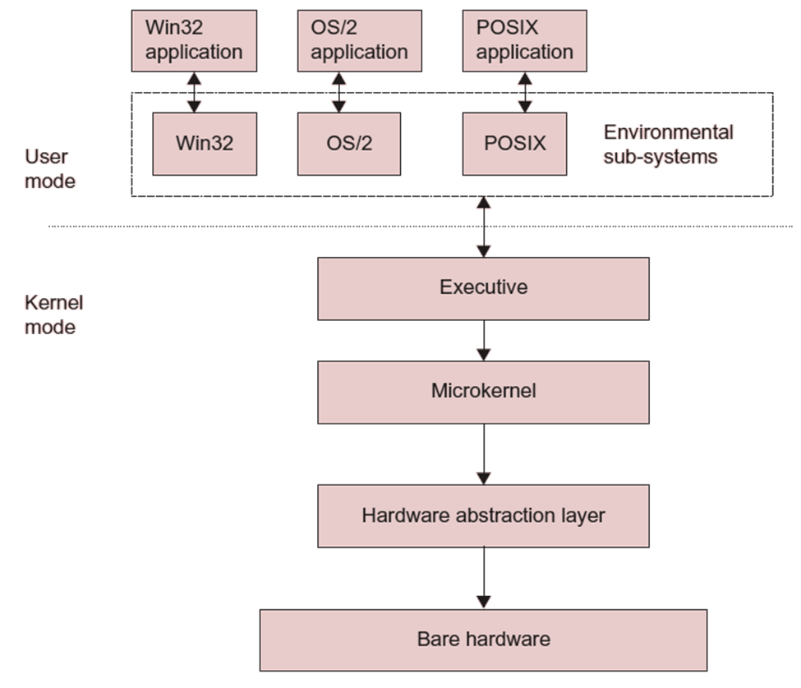
Windows hybrid architecture

Slide 25
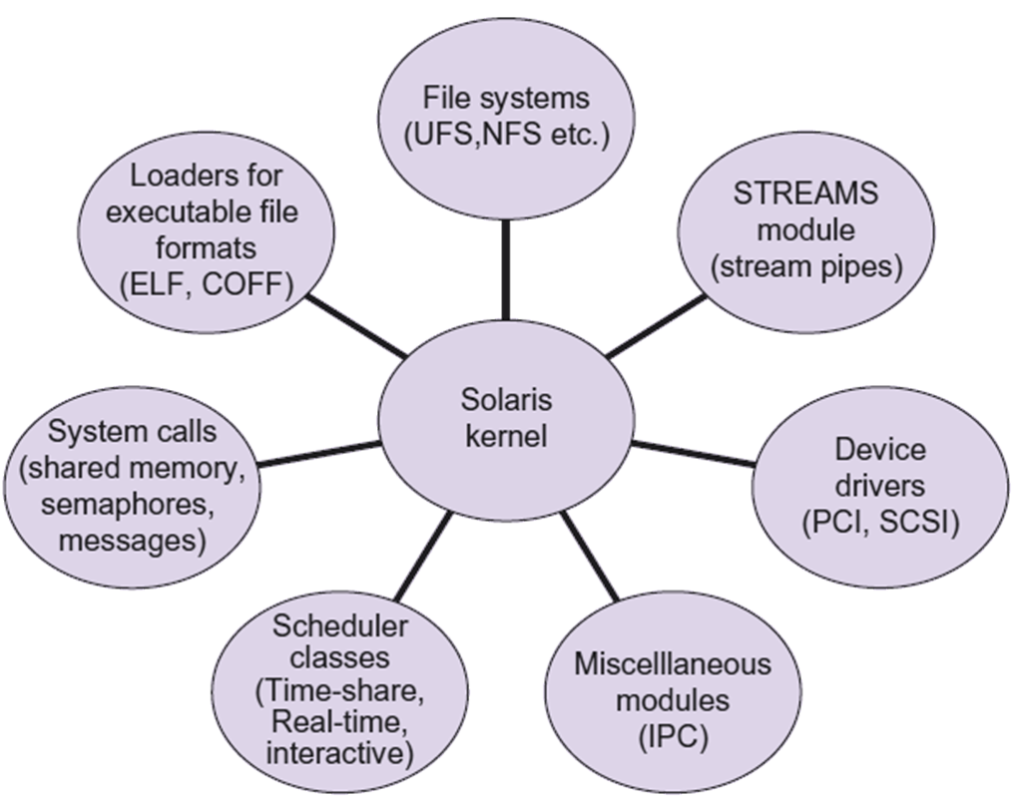
Modular Architecture

